Slide 1
PFAS ANALYSIS AND INTERVENTION
Melissa Salazar
Andrew Cullen, Brittany Saleeby

Slide 2
Background
Web based application to analyze and possibly implement interventions to prevent further contamination.
Analysis may be time consuming or the personnel to do the analysis is non-existent
The initial dataset came from a test site along the Santa Ana River
December 5, 2019

Slide 3
Process
Sourcing existing resources: CA Water Boards
https://www.waterboards.ca.gov/drinking_water/certlic/drinkingwater/EDTlibrary.html
Wrangling data to provide appropriate format for analysis
Standardizing the process to create consistency
Developing pipelines for long term analysis and insight generation
December 5, 2019

Slide 4
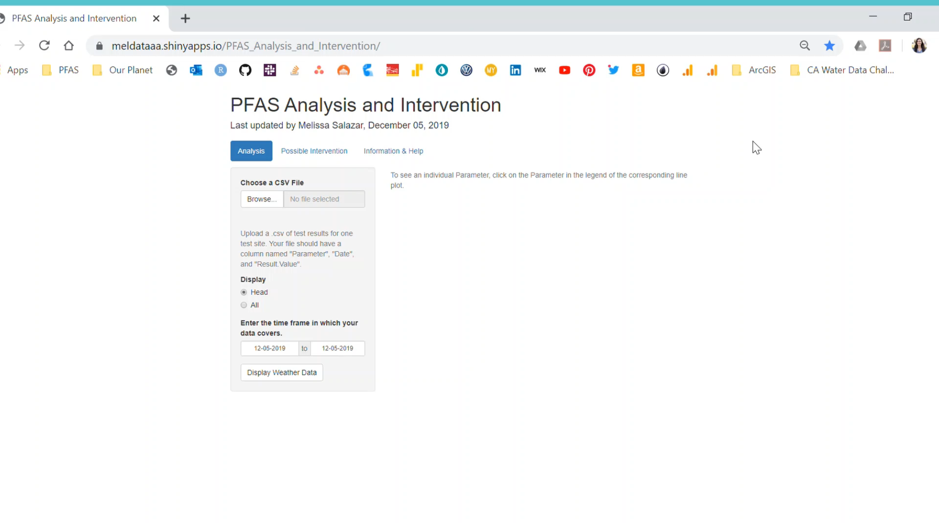
December 5, 2019

Slide 5
Summary
Future work
Minor code changes to improve efficiencies
Implement a weather API to bring in historical data as well as forecasted
https://meldataaa.shinyapps.io/PFAS_Analysis_and_Intervention/
https://github.com/CAWaterBoardDataCenter/PFAS-Analysis-and-Intervention
December 5, 2019

Slide 6
Thank you!
PFAS ANALYSIS AND INTERVENTION
Melissa Salazar
Andrew Cullen, Brittany Saleeby

